Slide 1


ADHIYAMAAN COLLEGE OF ENGINEERING (AN AUTONOMOUS INSTITUTION)
Approved by AICTE, Affiliated Anna University accredited by NBA & NAAC with A Grade.
Dr M G R Nagar, Hosur - 635 130, Krishnagiri (Dist.), Tamil Nadu, India.
DEPARTMENT OF ELECTRONICS AND COMMUNICATION ENGINEERING
MINI PROJECT
PROJECT TITLE
IoT-Enabled Biometric and OTP-Based Smart Vault Security System
PROJECT GUIDE:
Dr. S. Sumathi Professor /HoD Department of ECE
Adhiyamaan College of Engineering
PREPARED BY:
Suganth S.N (6176AC22UEC140)
Thameen Ansari. A (6176AC22UEC150) Vidyadheesha.M.Pandurangi (6176AC22UEC162) Yeshwanth. R (6176AC22UEC170)
B.E. ECE “C” – IV Year

Slide 2
INTRODUCTION
In today’s digital world, the need for enhanced security systems has become essential to protect valuable assets. Traditional lock-based vaults are prone to theft, duplication, and unauthorized access.
To overcome these limitations, this project proposes an IoT-based Smart Vault Security System that combines Biometric Authentication (Fingerprint) and OTP Verification for dual-layer protection.
The system ensures that only authorized users can access the vault, while real- time IoT connectivity allows monitoring and alert notifications through a mobile app or web interface.

Slide 3
PROBLEM STATEMENT
Traditional vault security systems that rely on mechanical locks, PINs, or key- based mechanisms are increasingly vulnerable to unauthorized access, duplication, hacking, and theft.
These conventional systems lack remote monitoring, user verification layers, and real-time alert mechanisms, making them ineffective in today’s digital and high-risk environments.
To address these limitations, there is a need for an intelligent, IoT-enabled security system that integrates biometric authentication and OTP verification to ensure multi-level protection.
Such a system should also be capable of remote status monitoring and instant notifications in case of unauthorized attempts, thereby providing a secure, reliable, and smart vault solution

Slide 4
OBJECTIVES
The main objective of this project is to design and implement a highly secure, IoT- enabled smart vault system that combines biometric authentication and OTP verification to ensure authorized access and real-time monitoring.
The specific objectives are:
    To develop a dual-layer authentication system using biometric (fingerprint) and OTP
    verification for enhanced security.
    To integrate IoT technology for real-time monitoring, data logging, and remote alerts through GSM or Wi-Fi modules.
    To automate vault operation using a microcontroller-controlled servo motor for
    locking and unlocking mechanisms.
    To provide instant alerts via SMS or IoT notifications in case of unauthorized access attempts.
    To ensure low power consumption and cost-effectiveness while maintaining high
    reliability and safety.

Slide 5
LITERATURE REVIEW
Authors & Year | Technology Used | Key Features | Limitations
S. Ramesh et al. (2019) | Fingerprint-based door locking system | Arduino with fingerprint sensor (R307) | Improved personal security, but lacked remote monitoring and IoT connectivity
A. Kumar & P. Sharma (2020) | Biometric locker system using fingerprint authentication | Microcontroller-based design with LCD and fingerprint sensor | Accurate biometric detection; no OTP or cloud integration
R. Patel et al. (2022) | OTP and RFID integrated entry system | RFID reader with GSM-based OTP verification | Provided two-step security but lacked IoT connectivity
M. Verma et al. (2022) | IoT-based vault monitoring system | NodeMCU with sensors and cloud dashboard | Real-time vault updates; used only password authentication

Slide 6
DISADVANTAGES OF EXISTING SYSTEM
Lack of Advanced Security:Traditional vaults depend on mechanical keys or simple PIN locks, which are vulnerable to duplication, password guessing, or physical tampering. This single-layer protection can easily be bypassed by unauthorized users, leading to theft or data loss.
Manual and Non-Automated Operation:Conventional vaults require manual control for locking and unlocking. They are not integrated with IoT or automation technologies, making them inconvenient and unsuitable for modern smart security needs where remote access and automatic control are essential.

Slide 7
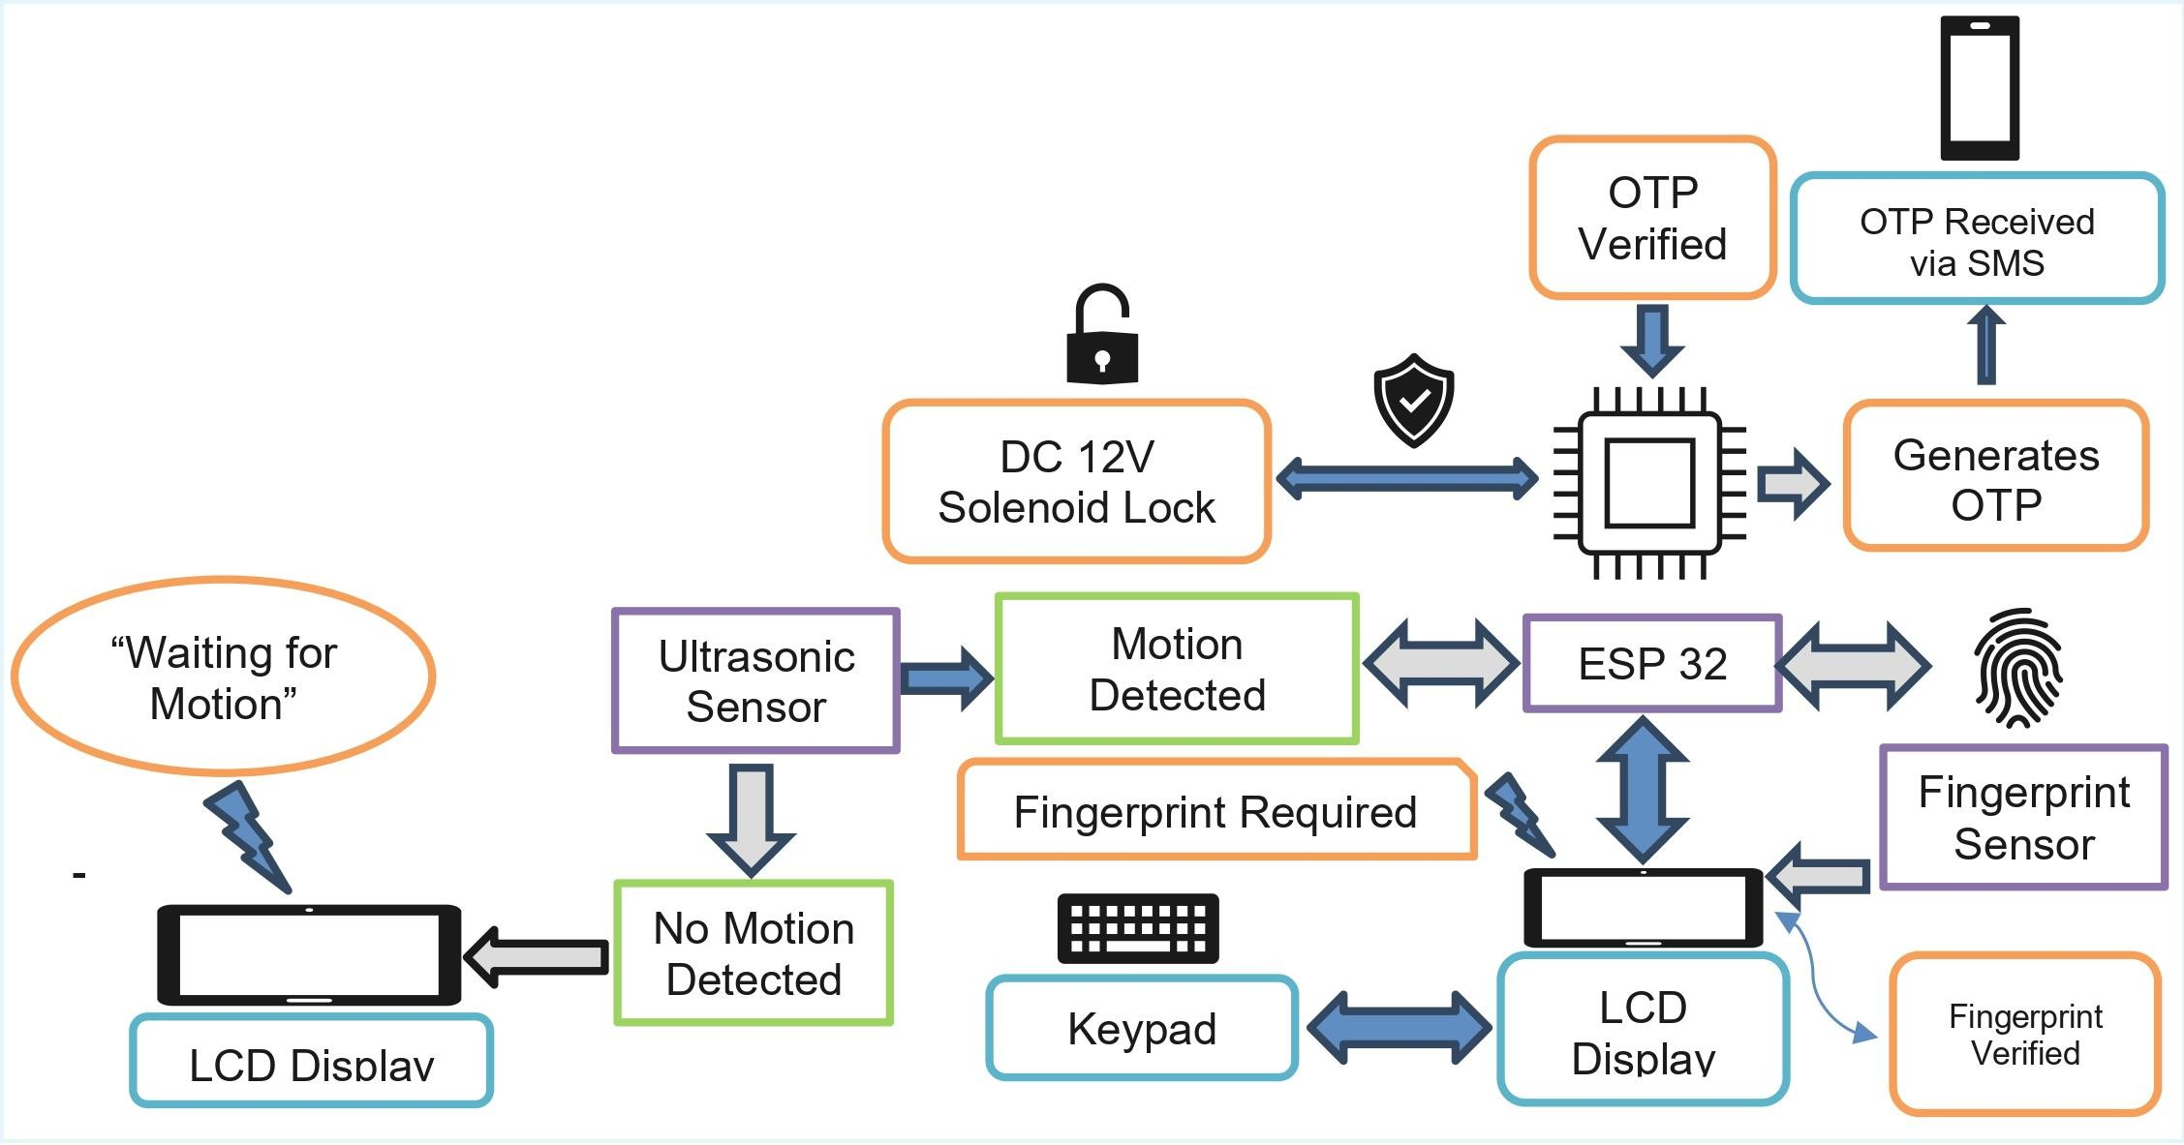
PROPOSED SYSTEM

Slide 8
WORKING EXPLANATION
1. System Initialization:
When powered ON, the microcontroller (Arduino/NodeMCU) initializes all connected modules — fingerprint sensor, GSM module, servo motor, and LCD display.
2. Fingerprint Authentication:
The user places their finger on the fingerprint sensor.
  1. If the fingerprint matches the stored data, the system proceeds to the next step.
  2. If it does not match, an alert is triggered through the buzzer or message, and access is denied.
3. OTP Generation and Verification:
Once the fingerprint is verified, the system generates a One-Time Password (OTP) and sends it to the
registered mobile number via the GSM module. The user must enter the received OTP to confirm identity.
4. Vault Unlocking:
If the entered OTP is correct, the servo motor activates to unlock the vault door automatically.
The LCD displays “Access Granted.”

Slide 9
5. Security and Alert System:
If an incorrect fingerprint or OTP is entered multiple times, the buzzer sounds and a warning SMS is sent to
the owner’s phone for immediate attention.
6. IoT Monitoring (Optional):
The system can send status updates (locked/unlocked, alert) to a cloud platform or mobile app for real-time monitoring.
7. Auto Lock and Reset:
After a preset time, the system automatically locks the vault again and resets itself for the next operation.

Slide 10
METHODOLOGY / SYSTEM DESIGN
Stage | Process Description
1. User Identification | The system scans the fingerprint of the user through a biometric sensor (R307/AS608).
2. Authentication Process | If the fingerprint matches the stored template, the system generates a One-Time Password (OTP) and sends it to the user’s registered mobile via GSM module (SIM900/SIM800L).
3. OTP Verification | The user enters the received OTP. If the OTP is valid, the system proceeds to unlock the vault; if invalid, an alert is raised.
4. Vault Control | The servo motor is activated to open or close the vault automatically. The LCD display shows status messages like “Access Granted” or “Access Denied.”
5. IoT Integration | Through the IoT module (NodeMCU or ESP8266), the system updates vault status (locked/unlocked/alert) to the cloud for remote monitoring.
6. Security Alert | On any unauthorized attempt (wrong fingerprint/OTP), the buzzer is triggered and an SMS alert is sent to the owner’s phone.
7. Auto Reset | After a successful or failed access attempt, the system resets and returns to the initial standby state for the next user.

Slide 11
HARDWARE USED
Tool / Component
Ultrasonic Sensor
ESP32
Breadboard
4x4 Keypad
LCD with I2C
Fingerprint Sensor Module
DC 12V Solenoid Lock
SOFTWARE USED
Software Tool
Arduino IDE Twilio API

Slide 12
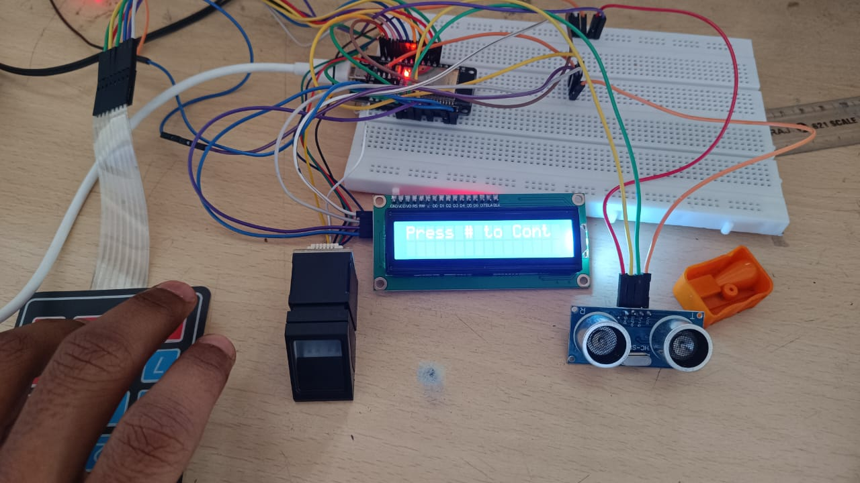
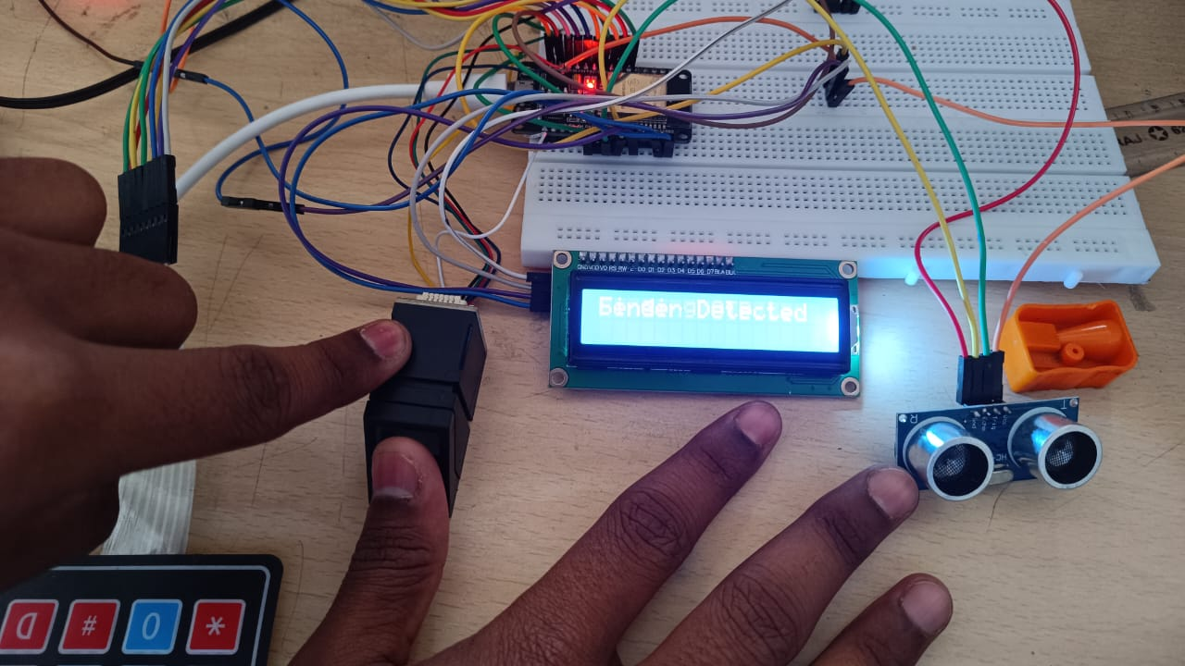
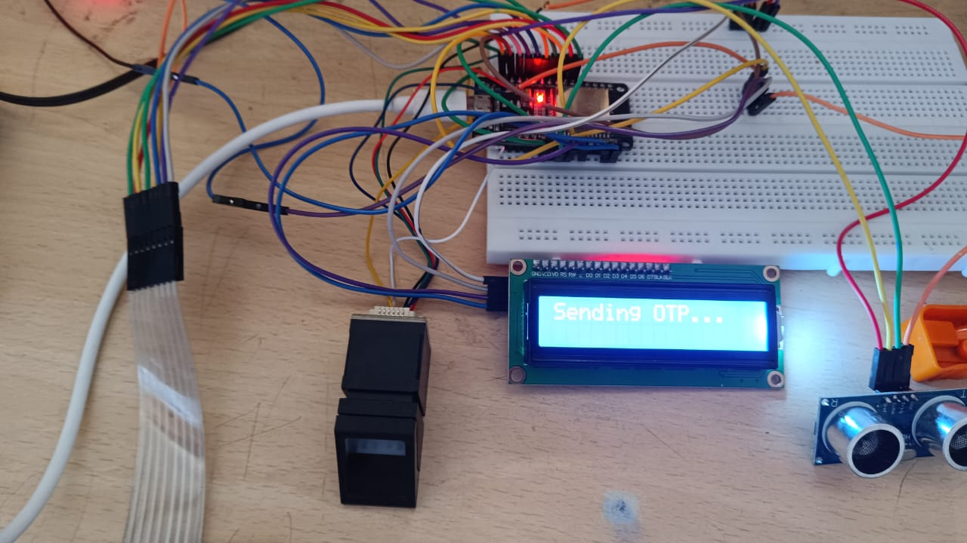
IMPLEMENTATION & RESULTS
Press # to verify the Finger print
Placing the Fingerprint to verify
Verifying the OTP to unlock the door

Slide 13
APPLICATIONS
1. Bank Lockers and ATM Vaults - Used in financial institutions to secure lockers and vaults with multi-factor authentication for authorized staff access only.
2. Home and Office Safes - Provides secure storage for valuables, documents, and cash with fingerprint and OTP verification.
3. Industrial Security Systems - Protects critical equipment, control rooms, and storage units by restricting unauthorized access.
4. Data Centers and Server Rooms - Ensures only verified personnel can access sensitive systems or data storage facilities.
5. Defense and Military Storage Units - Used to secure confidential files, weapons, or communication devices requiring high-level authentication.
6. Jewelry Shops and Showrooms - Protects valuable assets using IoT-based real-time monitoring and alert systems.
7. Smart Home Automation Systems - Can be integrated with IoT-based smart homes for intelligent and safe access control.

Slide 14
ADVANTAGES
Enhanced Security:Provides dual-layer protection using biometric authentication and OTP verification, reducing the risk of unauthorized access.
Real-Time Monitoring:IoT integration enables live status updates and remote monitoring of vault activity through cloud platforms or mobile apps.
Automatic Alerts:Sends SMS or IoT notifications instantly during unauthorized access attempts, ensuring quick response.
User-Friendly Operation:Simple and convenient access using fingerprint and OTP — no need to remember complex passwords or carry keys.
LIMITATIONS
  Dependence on Network Connectivity- The system relies on GSM or Wi-Fi for OTP generation and IoT monitoring. Poor network coverage may delay messages or alerts.
  Limited Power Backup - Since the system operates on a DC power supply, it may stop functioning during power failures unless a backup battery is provided.
  Single User Registration (Basic Version) - The prototype may support limited fingerprint templates, restricting multiple-user access in shared environments.

Slide 15
FUTURE SCOPE
Mobile App Integration: A dedicated Android/iOS app can be developed for remote monitoring, access control, and instant notifications with a user-friendly interface.
Cloud Data Storage: Implementing cloud-based data logging will help store access records, timestamps, and user activity for improved security analysis.
AI-Based Intrusion Detection: Artificial Intelligence can be used to detect unusual access patterns or multiple failed attempts and trigger predictive security measures.
Multiple User Management: Future versions can support multiple authorized users with separate fingerprint and OTP profiles for team or family access.
Voice or Face Recognition: The system can be upgraded with voice or facial recognition to add more advanced authentication layers.
Integration with Smart Home Ecosystem: The vault system can be linked with other IoT home devices like CCTV, alarms, and smart locks for complete security automation.

Slide 16
CONCLUSION
The IoT-Enabled Biometric and OTP-Based Smart Vault Security System provides an advanced, reliable, and multi-layered security solution for safeguarding valuables. By integrating biometric authentication, OTP verification, and IoT connectivity, the system ensures that only authorized users can access the vault.
It eliminates the weaknesses of traditional lock systems, which can be easily duplicated or tampered with. The real-time monitoring and alert notifications enhance the overall safety and convenience for users.
This smart security system is cost-effective, energy-efficient, and scalable for various applications like homes, banks, and offices. Overall, the project successfully demonstrates how
modern IoT and biometric technologies can be combined to create a secure, user-friendly, and intelligent vault system

Slide 17
REFERENCES
A. Kumar, R. Sharma, and P. Singh, “IoT Based Smart Security System Using Biometric and OTP Authentication,” International Journal of Advanced Research in Electronics and Communication Engineering (IJARECE), Vol. 9, No. 4, 2023.
S. Gupta and M. Verma, “Design and Implementation of IoT-Enabled Security Systems,” International Journal of Innovative Research in Computer and Communication Engineering (IJIRCCE), Vol. 10, No. 7, 2022.
P. Kaur and D. Mehta, “Biometric Authentication in Smart Security Systems,” IEEE International Conference on Smart Technologies and Management for Computing, Communication, Controls, Energy and Materials (ICSTM), 2021.
R. S. Patel and T. Desai, “Enhancing Home and Vault Security Using IoT and GSM Modules,” International Journal of Emerging Technology and Advanced Engineering (IJETAE), Vol. 12, No. 5, 2022
A. Bansal, “Integration of IoT and Biometric Systems for Enhanced Security Applications,” Journal of Information and Computational Science, Vol. 14, No. 9, 2023.

Slide 18
ANY QUERIES?

Slide 19
THANK YOU

